Slide 1
Traffic Signal Optimization (Rule-Based)
Team Members:
2520030529-Thrinadh
2520030531-Venya Shri
2520030536-Teja Sadwika

Slide 2
INTRODUCTIon
Traffic congestion has become a major problem in urban areas due to the rapid increase in the number of vehicles on roads. Traditional traffic signal systems use fixed timing mechanisms, which often fail to manage varying traffic conditions efficiently. This results in unnecessary delays, fuel wastage, increased pollution, and traffic jams.
To overcome these issues, this project proposes a Traffic Signal Optimization System using a Rule-Based Approach. The system analyzes real-time traffic density using sensors or cameras and dynamically adjusts signal timings using heuristic rules and decision logic without Machine Learning. The proposed solution improves traffic flow, reduces waiting time, and provides an efficient, cost-effective, and reliable traffic management system for smart cities

Slide 3
Problem statement
Traditional traffic signal systems use fixed timing mechanisms that do not adapt to real-time traffic conditions. This often leads to traffic congestion, long waiting times, fuel wastage, and increased pollution, especially during peak hours. Roads with heavy traffic receive the same signal timing as low-traffic roads, resulting in inefficient traffic management. Therefore, an intelligent and cost-effective system is needed to dynamically optimize traffic signal timings and improve overall traffic flow.

Slide 4
Objectives of the Project
Reduce traffic congestion at road intersections
Optimize traffic signal timings using heuristic rules
Improve overall vehicle movement efficiency
Minimize unnecessary waiting time for vehicles
Demonstrate the practical application of rule-based AI techniques
Provide a simple, reliable, and cost-effective traffic management solution

Slide 5
Technologies Required
Software
Python
VS Code / PyCharm
Python Libraries:
time
random
Hardware (Optional for Real-Time Implementation)
Traffic Sensors
Camera Modules
Arduino / Raspberry Pi
Concepts Used
Rule-Based AI Techniques
Heuristic Rules
Computational Decision Logic
Traffic Density Analysis

Slide 6
Why This Project?
🚦 Increasing vehicle population causes severe traffic congestion in cities.
⏳ Fixed-time traffic signals cannot handle changing traffic conditions efficiently.
🚗 Vehicles waste fuel and time while waiting at signals unnecessarily.
🧠 A smart rule-based traffic system can dynamically optimize signal timings and improve road efficiency.

Slide 7
Existing System vs Proposed System
Existing System | Proposed System
Uses fixed signal timings | Uses dynamic signal timings
Cannot adapt to traffic density | Adjusts signals based on vehicle count
Causes longer waiting time | Reduces unnecessary delays
Inefficient during peak hours | Optimizes traffic flow efficiently
Higher fuel wastage | Reduces fuel consumption
Limited intelligence | Uses rule-based AI decision logic

Slide 8
System Architecture
📷 Traffic Sensors / Cameras ⬇ 📊 Traffic Density Detection ⬇ 🧠 Rule-Based Decision Engine ⬇ 🚦 Dynamic Signal Time Allocation ⬇ 🚗 Optimized Traffic Flow

Slide 9
Workflow of the System
Step 1: Traffic Data Collection
Sensors or cameras detect the number of vehicles on each road.
Step 2: Traffic Density Analysis
The system analyzes traffic conditions in real time.
Step 3: Rule Evaluation
Heuristic rules and decision logic are applied.
Step 4: Signal Optimization
Green signal time is adjusted dynamically based on traffic density.
Step 5: Continuous Monitoring
The process repeats continuously for smooth traffic flow management.

Slide 10
Heuristic Rules Used
🚦 If traffic density is high → Increase green signal duration
🚦 If traffic density is low → Reduce green signal duration
🚑 Emergency vehicles receive immediate priority
🕒 Peak-hour traffic receives extended signal timing
🚶 Pedestrian crossing safety rules can also be included for better road management

Slide 11
Advantages of the Proposed System
Reduces traffic congestion at intersections
Minimizes vehicle waiting time
Improves overall traffic flow efficiency
Saves fuel and reduces air pollution
Simple, reliable, and cost-effective implementation
No Machine Learning or complex training required
Suitable for smart city traffic management systems

Slide 12
Results and Expected Output
📈 Roads with higher vehicle density receive longer green signals
⏱️ Waiting time at intersections is reduced significantly
🚗 Traffic movement becomes smoother and more efficient
⛽ Fuel consumption and vehicle idling are minimized
🌍 Reduction in traffic congestion and environmental pollution
✅ Better performance compared to traditional fixed-time traffic signals

Slide 13
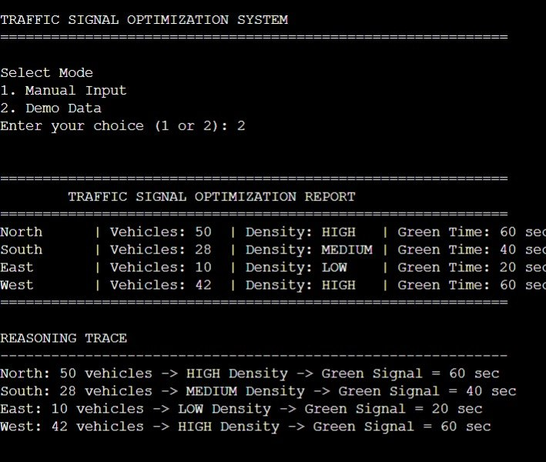
output

Slide 14
Conclusion
The Rule-Based Traffic Signal Optimization System provides an efficient and practical solution for managing urban traffic congestion. By using heuristic rules and computational decision logic, the system dynamically adjusts traffic signal timings according to real-time traffic density without relying on Machine Learning techniques. The proposed approach improves traffic flow, reduces waiting time, minimizes fuel consumption, and offers a simple, reliable, and cost-effective solution for smart traffic management.

